Slide 1
A three-pronged effort to improve
post-publication critique & error detection
Ian Hussey

Slide 2
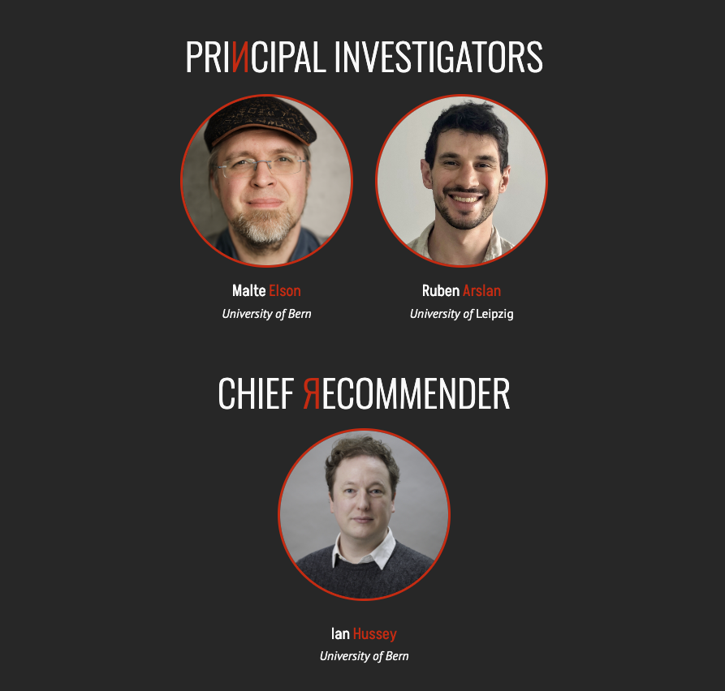

Slide 3
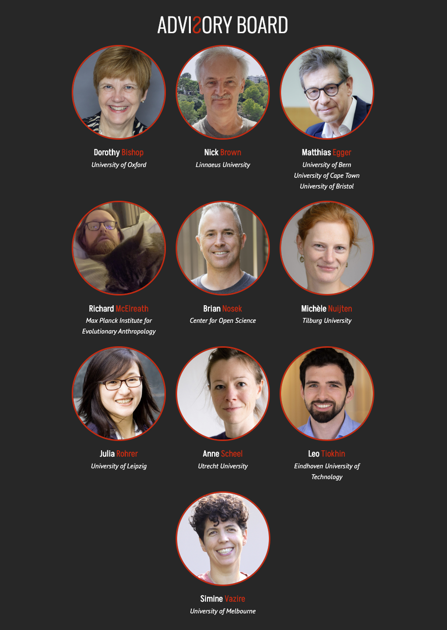

Slide 4

We ask too much of peer-review
Scientific
Truth
X
One-shot, little redundancy
Despite imperfect reliability & evolving knowledge
X
Generally non-technical
Peer Review
X
Surprising little error checking
for an industry built on discovering truth
Notes:
Need parallel systems of scientific verification

Slide 5
Errors are broadly conceived
‘An act that through ignorance, deficiency,
or accident departs from or fails to achieve what should be done’

Slide 6
Errors are broadly conceived
౿ Includes both provable & probable errors
౿ Goes beyond computational reproducibility
౿ Hard to check errors and not also scrutinize more generally, eg flexibility, robustness, measurement

Slide 7
Who can help carry this burden?
Need for parallel systems
of scientific verification
Notes:
You all know the obvious solution, but it hasn’t worked - yet

Slide 8
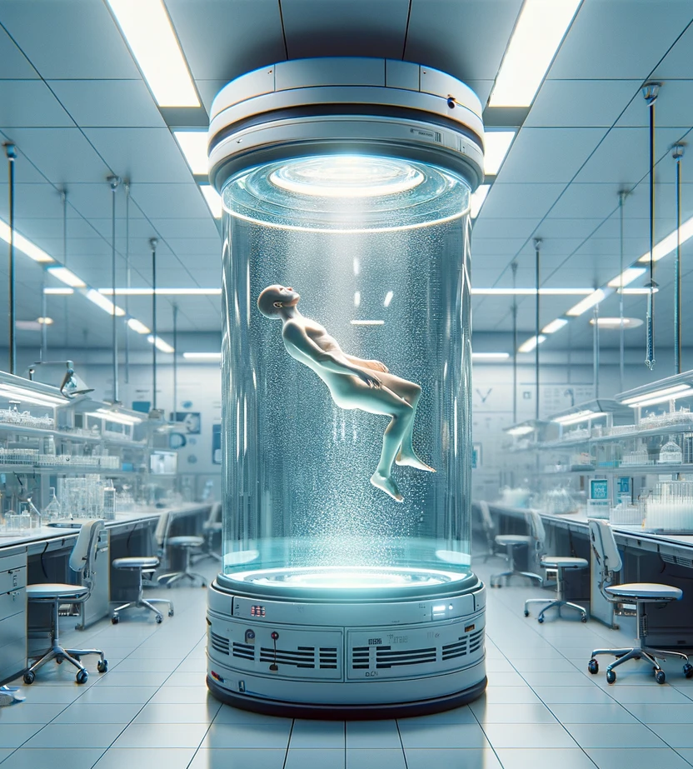
Who can help carry this burden?
Need for parallel systems
of scientific verification
A clone-army of Nick Browns

Slide 9

Who can help carry this burden?
“A few outsiders and weirdos saw the giant lie at the heart of [science], and they saw it by doing something the rest never thought to do:
They looked.”
Notes:
Jokes aside, the likes of Nick Brown, James Heathers, Elisabeth Bik, and many other folk who go unnamed and correct science for little thanks are .. just cool as hell. The punk rock of science.
For me, they always bring to mind my favourite line from my favourite movie.
These people are an invaluable asset to science. And at the same time, that’s a problem.

Slide 10
Lessons from the Open Science/methods reform movement
౿
Thought leaders and experts are important
౿
But reliance on a few diligent experts isn’t scalable
౿
You also need a grassroots, ECR-driven movement
౿
And probably a stack of money too
Notes:
A full spectrum approach. Not this or that, but all of it.

Slide 11
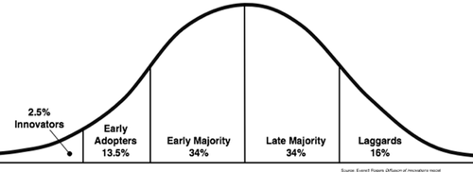
Centre for Open Science’s strategy to increase
preregistration & data sharing
Nosek (2019)

Slide 12
Centre for Open Science’s strategy to increase
preregistration & data sharing
Make it required
Policy
Incentives
Make it rewarding
Communities
Make it normative
User Interface/Experience
Make it easy
Infrastructure
Make it possible
Nosek (2019)

Slide 13
Our strategy to increase error
checking, reporting, & correction
Make it required
Make it rewarding
Make it normative
Make it easy
Make it possible

Slide 14


Our strategy to increase error
checking, reporting, & correction
Make it required
Make it required
Make it rewarding
Make it rewarding
Make it normative
Make it normative
Make it easy
Make it easy
Availability of data & code
Existence of error detection methods
Make it possible
Make it possible

Slide 15
Our strategy to increase error
checking, reporting, & correction
Make it required
Make it required
Policy
ERЯOR
rewards
Make it rewarding
Make it rewarding
Communities
& teaching
Make it normative
Make it normative
Discoverable & usable
error detection methods
Make it easy
Make it easy
Availability of data & code
Existence of error detection methods
Make it possible
Make it possible

Slide 16
Make it easy
Increasing the discoverability & usability
of error detection methods
01.
02.
Make it normative
A master’s degree course in error detection
03.
Make it rewarding
ERЯOR: A bug bounty program for science

Slide 17
Increasing the
discoverability & usability
of error detection methods
01.

Slide 18
01.
An ecosystem of
error checking methods
Methods to scrutinise the article, data, code, or
the relationships among them
Smoke vs fire methods
Often
Very simple math
Exploiting overlooked details & repetition
Established principles redeployed for error detection

Slide 19
01.
‘The scientific article’
is a well-defined genre
“No handbooks exist for writing replies”
(Hyman, 1995)
…maybe we need to write one

Slide 20
01.
Repetition & recalculation methods
StatCheck
“t(58) = 1.46, p = .03” ➔ p = .19

Slide 21
01.
Repetition & recalculation methods
StatCheck
“t(58) = 1.46, p = .03” ➔ p = .19

Slide 22
01.
Repetition & recalculation methods
StatCheck
GRIM
“two people rated the statement’s
believability on a 1-5 scale (mean = 2.7)”
➔ mean must end in .0 or .5

Slide 23
01.
Repetition & recalculation methods
StatCheck
GRIM / GRIMMER / GRIMMEST
SPRITE

Slide 24
01.
Repetition & recalculation methods
StatCheck
GRIM / GRIMMER / GRIMMEST
SPRITE
RIVETS
DEBIT
Reproduce effect-sizes & test statistics from summary statistics
…
R packages, vignettes, how-to guides, blogs, & examples needed!

Slide 25
01.
‘Shoe-Leather’ error checking
Unfortunate lack of acronyms!
Full sample - exclusions = analytic sample size?
Means inside scale range?
“Sum scores on the five-item scale (response options 1-7) … Mean = 38.1” ➔ [5, 35]
Point estimates inside the confidence intervals?
“β = .11, 95% CI [.27, .53]”
…
Nick Brown is king of this - but there are no training materials

Slide 26
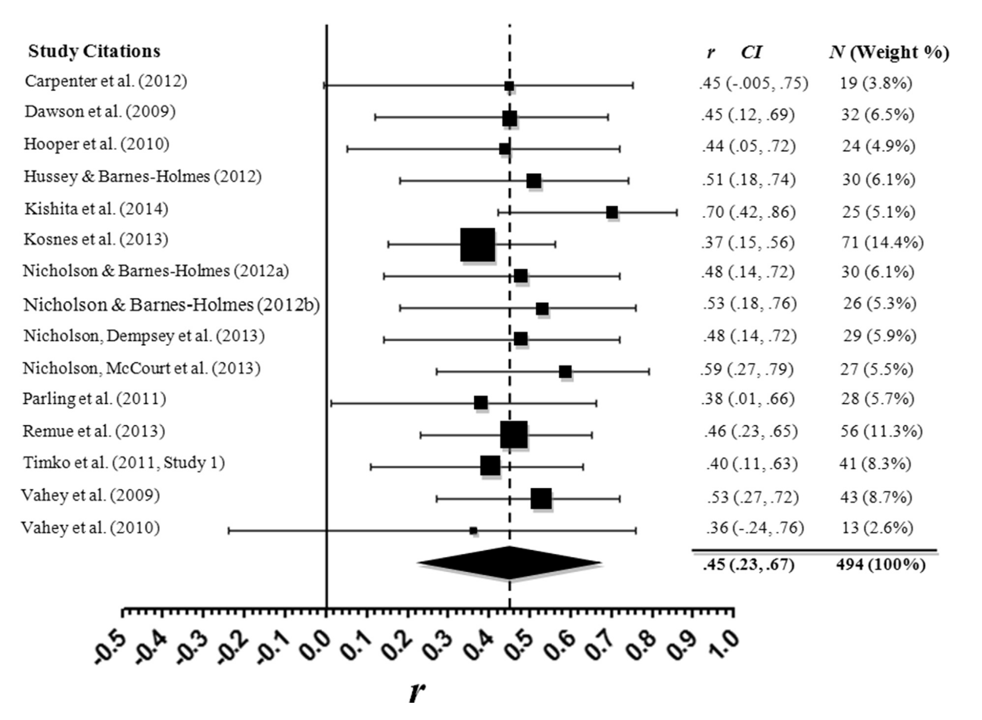
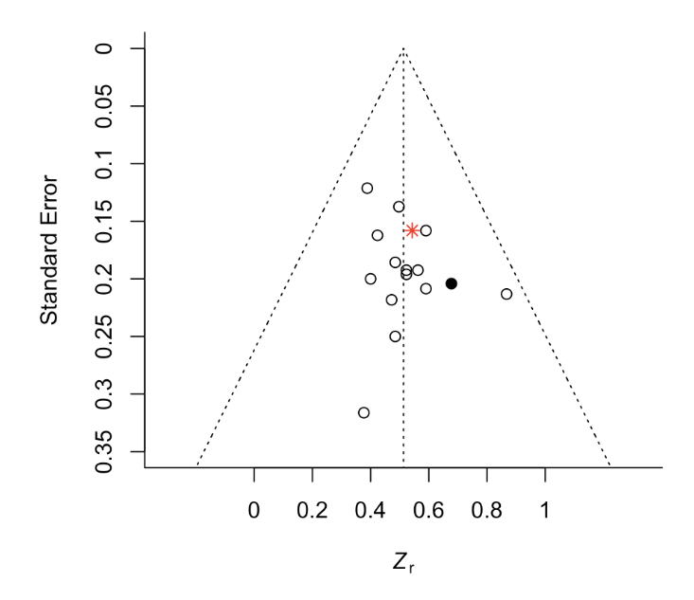
01.
Forest plot = funnel plot?
From Vahey et al. (2015)

Slide 27
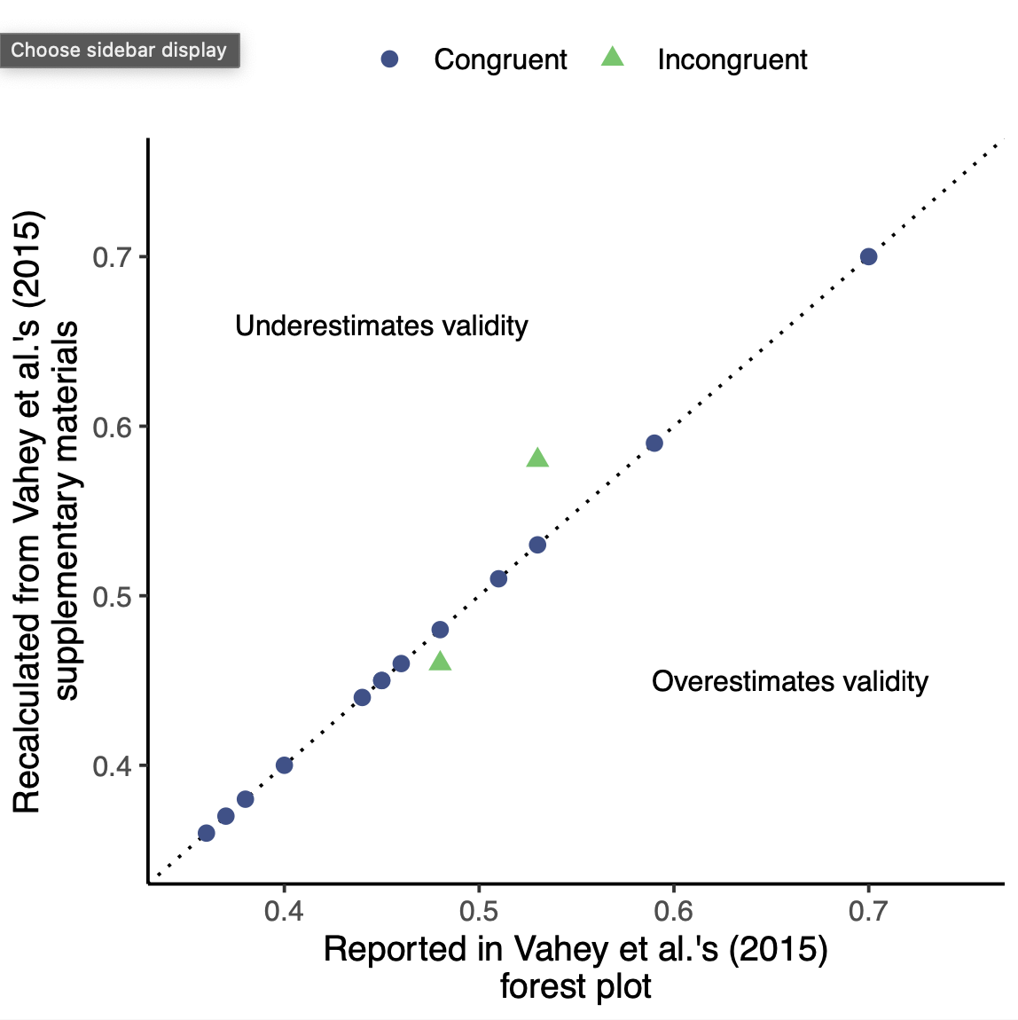
01.
Meta-analysis effect sizes = effect sizes in original paper?
See Maassen et al. (2020)

Slide 28
01.
Inferential & argumentation errors
Citation errors
9% completely mischaracterised (Cobb et al, 2023)
Difference between signif. & non-signif. is not itself significant (Gelman, 2006)
Reverse causality
Suicide literature: current depression “predicts” historic suicide attempt
Confusing DV/IV (Fried & Kievit, 2015)
…

Slide 29
01.
A foreseeable output:
A handbook for error detection
What do you have?
Article, measures, data, code, the original authors’ good-will?
How can you get more?
Extracting additional data (plots, tables, summary statistics, asking)
What could you check?
How to prioritise?
What are the authors’ claims? (Scheel, 2022)
How to ensure reproducibility of checks?
How to effectively communicate error checks

Slide 30
01.
What’s wrong with these correlations?
B
r = .79
r = -.10
A
C
r = .66
Notes:
We need new error detection methods too

Slide 31
01.
What’s wrong with these correlations?
B
r = .79
r = -.10
A
C
Can’t be this low!
[.06, .98]
r = .66
Restrictions on correlations (Stanley & Wang, 1969)
Notes:
Trigonometry

Slide 32
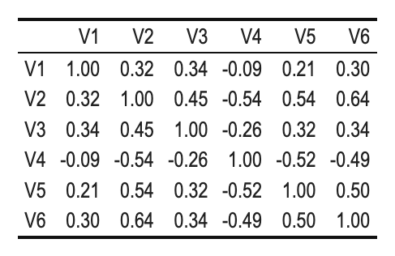
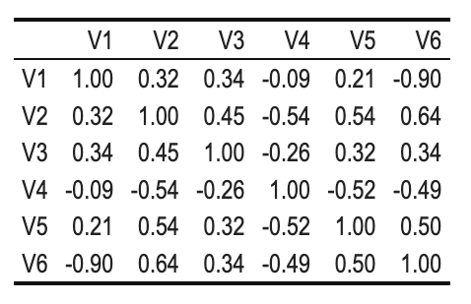
01.
Which correlation table contains an error?
Hard to spot by eye; easier with code

Slide 33
01.
Reusing Correlations for Validation and Regression (RECOVAR)
Positive-definite
Non-positive-definite

Slide 34
01.
Reusing Correlations for Validation and Regression (RECOVAR)
Method development
Statistical power?
Corrections for rounding?
Triangulation of problematic correlations?
Application
Estimate prevalence of errors in correlation tables using the MetaBUS dataset (>16k publications)
Bosco et al. (2015)

Slide 35
01.
Reusing Correlations for Validation and Regression (RECOVAR)
Fit regressions using correlation tables rather than data
Reproducibility
Robustness
Probe researchers' implicit causal assumptions
V1 ~ V2 + V3 + V4
Notes:
Established knowledge can get repurposed for error detection purposes
“How much sleep is best for the brain”
Never
“How much brain is best for sleep”

Slide 36
A master’s degree course
in error detection
02.

Slide 37
02.
Conspicuous absence
of error detection in the curriculum
Defence against the dark arts:
a proposal for a new MSc course
(Bishop, 2023)
Notes:
You know how to read and write them.
Google hits for “how to write” vs “how to critique”

Slide 38
02.
‘Normalise’ is a verb
Masters course:
“Estimating the credibility of past research”
(@UniBe from Fall ’23)
Science as an intensely human & fallible activity
Organised skepticism

Slide 39
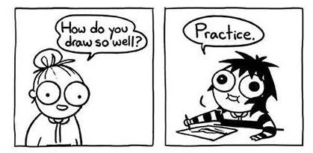
02.
Error check

Slide 40
02.
Syllabus
Functions of science other than truth discovery
p-curve, StatCheck, GRIM, GRIMMER, SPRITE, RECOVAR
Recomputing results from summary statistics
Effect size plausibility
Reliability corrections
Meta-analysis bias detection & its failures
(Missing) causal language
Construct validity evidence
Spotting nominative/jingle/jangle fallacies
Obtaining & extracting data
Communicating errors + examples of critique
Not merely information, practice!
Notes:
Srivistiva (2016) “Everything is fucked” syllabus
Bernal

Slide 41
02.
Problems encountered
Permission to critique
xxxxxxxxxx
Language of critique
Exposure & Practice!
Notes:
Day 1 I asked them questions about their knowledge of the replicability crisis, their belief about what proportion of the studies replicated etc.
Assignment 1 they wrote that science is entirely self correcting, errors are rare, there is no problem
Student feedback
Error checking increases understanding of statistics
They want this information earlier in their studies

Slide 42
ERЯOR
A bug bounty program for science
03.

Slide 43
250,000 CHF
(€260k, $285k)
fund

Slide 44
Check
100
published articles
for errors

Slide 45
Pay authors & reviewers
+ bonus reward
contingent on errors found

Slide 46
 | Base | Bonus reward
Author | CHF 250 | Up to 250 CHF
Reviewer | c.250 − 1,000 CHF Depending on expected effort | Up to 2,500 CHF
Indicative ranges; will be scaled for regional differences

Slide 47
Goals
౿
Explore and test practical challenges in the
implementation of an error checking system
౿
Estimating a benefit-cost ratio of an error detection system relative to not detecting these errors
౿
Obtaining empirical estimates of the
types of errors & their prevalence

Slide 48
Selected for ‘importance’: Would matter if it contained errors
Recent (c.10 years)
Suggestions welcome
Especially self-nominations
Not randomly sampled
Attention paid to gender balance etc.
01.
Candidate articles
02.
Obtain author consent
03.
Match with reviewer

Slide 49
Consent to have their publicly available scientific output scrutinised by peers + get paid for it
Pre-commit to:
Sharing materials
Answering reasonable questions
Professional conduct
Acting on any recommendations
01.
Candidate articles
02.
Obtain author consent
03.
Match with reviewer

Slide 50
Volunteers welcome!
Non-anonymous
Can ask author reasonable questions to aid their work
Pre-commit to professional conduct
01.
Candidate articles
02.
Obtain author consent
03.
Match with reviewer

Slide 51
Checked by recommender
- Claims must be substantiated
Recommender can ask to modify/correct/edit
Move material from ‘Errors’ section to ‘Broader critiques’ section
Published on error.reviews website
CC-By 4.0 licence
04.
Error report
05.
Author response
06.
Decision, recommendation,
& reward payments

Slide 52
Optional, timely
Recommender can ask to modify/correct/edit
Published on error.reviews website
CC-By 4.0 licence
04.
Error report
05.
Author response
06.
Decision, recommendation,
& reward payments

Slide 53
Recommender makes a decision & any associated recommendation
Possibly in conjunction with the advisory board
04.
Error report
05.
Author response
06.
Decision, recommendation,
& reward payments

Slide 54
Recommendations
Decision | Recommendation
No errors | No additional action beyond publication of error report on the error.reviews website.
Minor errors | Authors to appropriately recognise these errors in future discussions of the article. Probably most research!
Indeterminable errors | No determination could be made re the presence or absence of important potential errors. Less desirable than verifiably minor errors! Authors to appropriately recognise this lack of verifiability in future discussions of the article.
Moderate errors | Correction notice (minor)
Major errors | Correction notice (major) / may warrant an expression of concern
Severe errors | Retraction

Slide 55
Bonus rewards
Decision | Recommendation | Bonus reward (indicative)
No errors | No additional action beyond publication of error report on the error.reviews website. | 250 CHF to the author
Minor errors | Authors to appropriately recognise these errors in future discussions of the article. Probably most research! | 250 CHF to both the author & reviewer
Indeterminable errors | No determination could be made re the presence or absence of important potential errors. Less desirable than verifiably minor errors! Authors to appropriately recognise this lack of verifiability in future discussions of the article. | 250 CHF to the reviewer
Moderate errors | Correction notice (minor) | 500 CHF to the reviewer
Major errors | Correction notice (major) / may warrant an expression of concern | 1000 CHF to the reviewer
Severe errors | Retraction | 2500 CHF to the reviewer

Slide 56
Our strategy to increase error
checking, reporting, & correction
Make it required
Make it required
Policy
ERЯOR
rewards
Make it rewarding
Make it rewarding
Communities
& teaching
Make it normative
Make it normative
Discoverable & usable
error detection methods
Make it easy
Make it easy
Availability of data & code
Existence of error detection methods
Make it possible
Make it possible

Slide 57

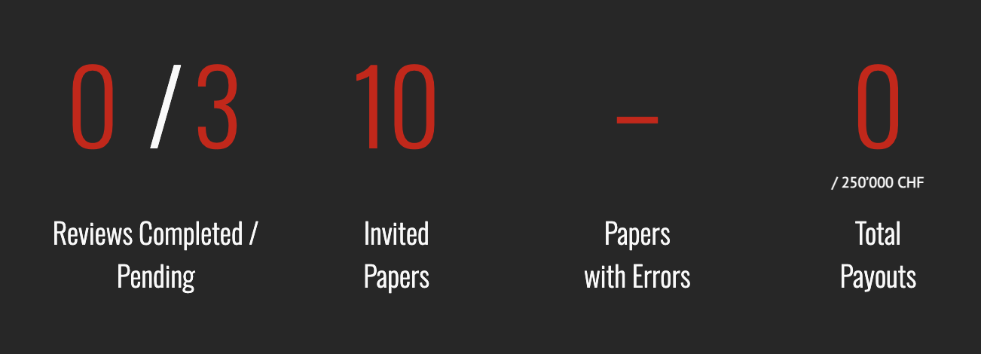

Slide 58
error.reviews

Slide 59
Acknowledgements
Collaborators
Malte Elson
Ruben Arslan
Frank Bosco
Beth Clarke
Alex Holcombe
Imran Kadolkar
ERROR authors & reviewers to date
Dale Barr
Lisa DeBruine
Emma Henderson
Gordon Pennycook and colleagues
Daniel Simons
Jan Wessel
Contact
ian.hussey@unibe.ch
Twitter: @ianhussey
https://error.reviews
error-reviews.psy@unibe.ch
Twitter: @error_reviews

Slide 60
Other normalisation efforts:
“Commentaries don’t get cited”
 | Citations of target article | Citations of commentary | Within-pair proportion
Mean | 106 | 5 | 25%
Median | 80 | 10 | 15%
Minimum | 2 | 1 | 1%
Maximum | 490 | 53 | 150%
N = 36 commentaries published in Psychological Science
between 2007-2021

